Slide 1
Building Graphical User Interfaces
Part I: Components & layout
7.0

Slide 2
Overview
Constructing GUIs
Interface components
GUI layout
Event handling
Styling

Slide 3
GUI Principles
Components: GUI building blocks.
Buttons, menus, sliders, etc.
Layout: arranging components to form a usable GUI.
Using layout managers.
Events: reacting to user input.
Button presses, menu selections, etc.
Styling: making things look nice
In code vs using CSS

Slide 4
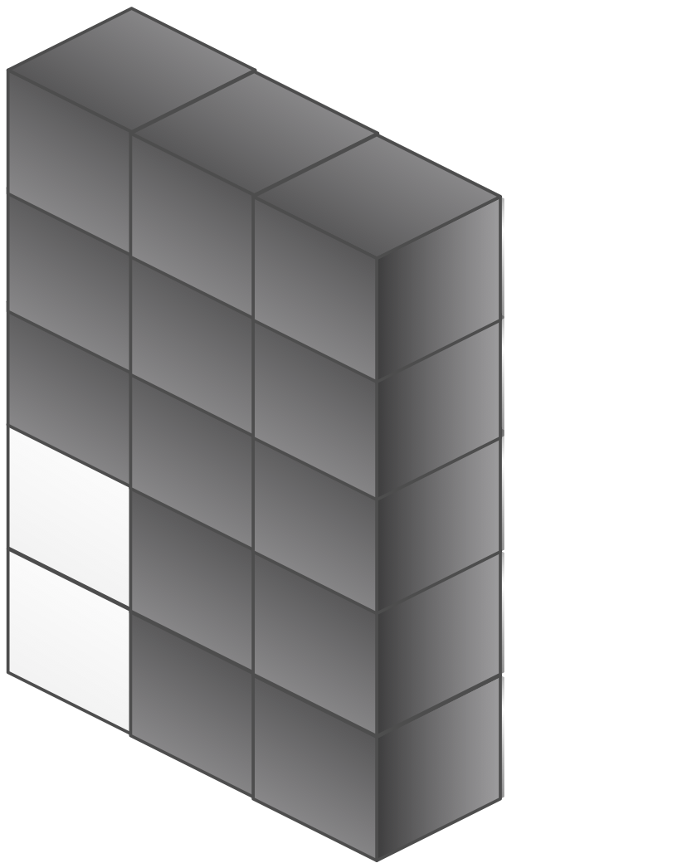
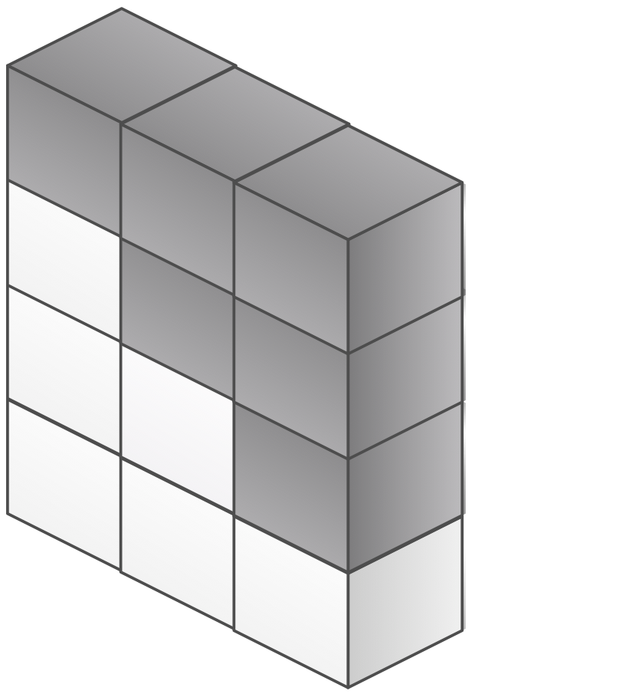
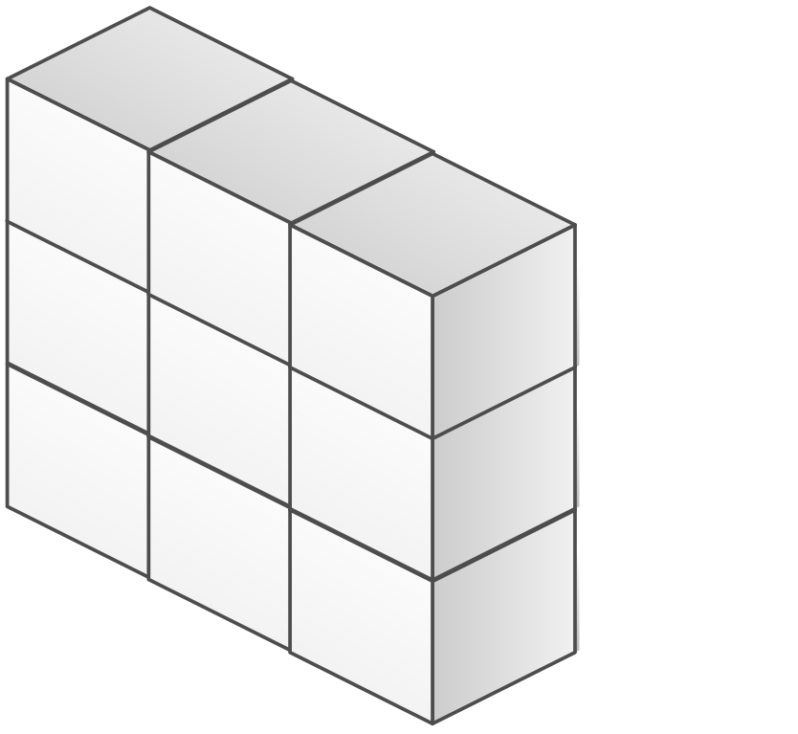
AWT, Swing and JavaFX
Swing
JavaFX
AWT
AWT
AWT

Slide 5
Java FX
Included with Java SE since JDK 7
Currently not included in the standard Java download, but available separately
BlueJ includes JavaFX
Used in code via import javafx. …

Slide 6
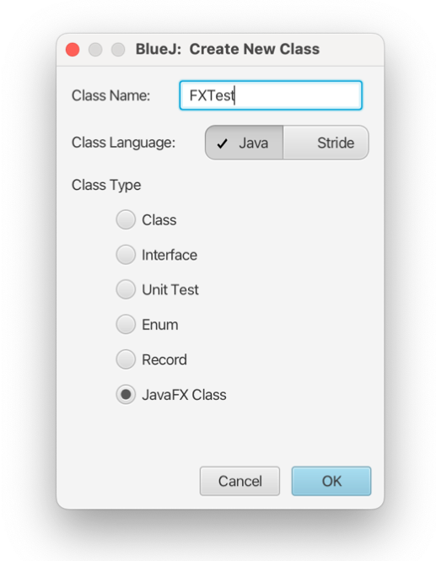
Creating a JavaFX Application

Slide 7
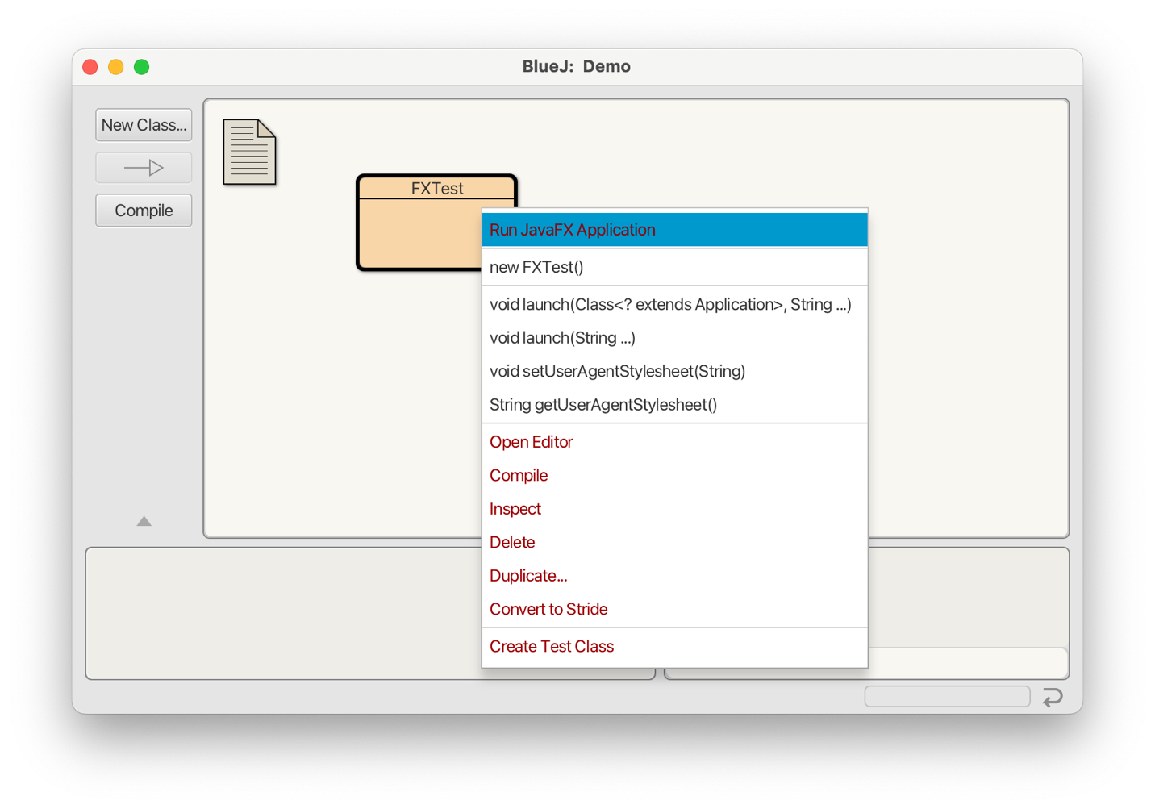
Starting a JavaFX Application

Slide 8
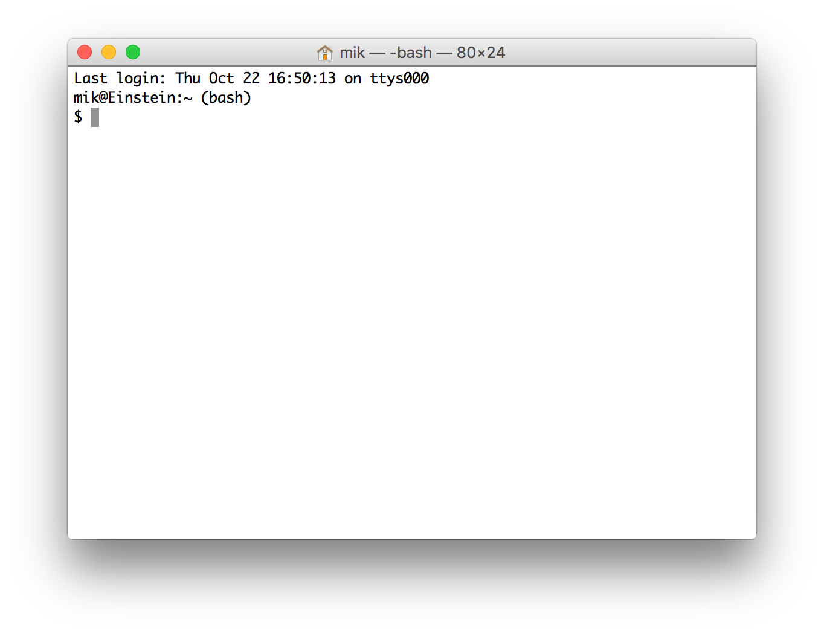
Stage (Window)
Title
Scene (window content)

Slide 9
Stage (Window)
Title
Label
Label
StackPane (“root”)
(a layout node”)
Scene (window content)

Slide 10
Stage
Scene
StackPane
Label

Slide 11
Stage (Window)
Title
Label
Label
Label
StackPane (“root”)
(a layout node”)
Scene (window content)

Slide 12
Stage
Scene
StackPane
Label
Label

Slide 13
Stage
Scene
StackPane
Label
Label
a scene graph

Slide 14
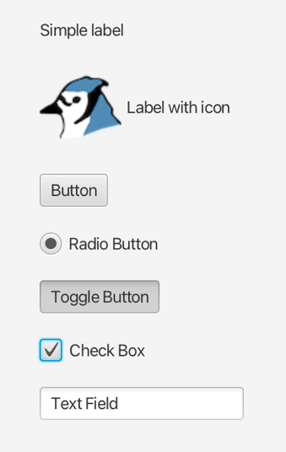
Some JavaFX Controls

Slide 15
Controls
Label
Button
Radio Button
Toggle Button
Checkbox
Choice Box
Text Field
Password Field
Scroll Bar
Scroll Pane
List View
Table View
Tree View
Tree Table View
Combo Box
Separator
Slider
Progress Bar and Progress Indicator
Hyperlink
Tooltip
HTML Editor
Titled Pane and Accordion
Menu
Color Picker
Date Picker
Pagination Control
File Chooser
https://docs.oracle.com/javafx/2/ui_controls/jfxpub-ui_controls.htm

Slide 16
Java FX Layout Panes
BorderPane
HBox
VBox
StackPane
GridPane
FlowPane
TilePane
AnchorPane

Slide 17
Building an Application
ImageViewer

Slide 18
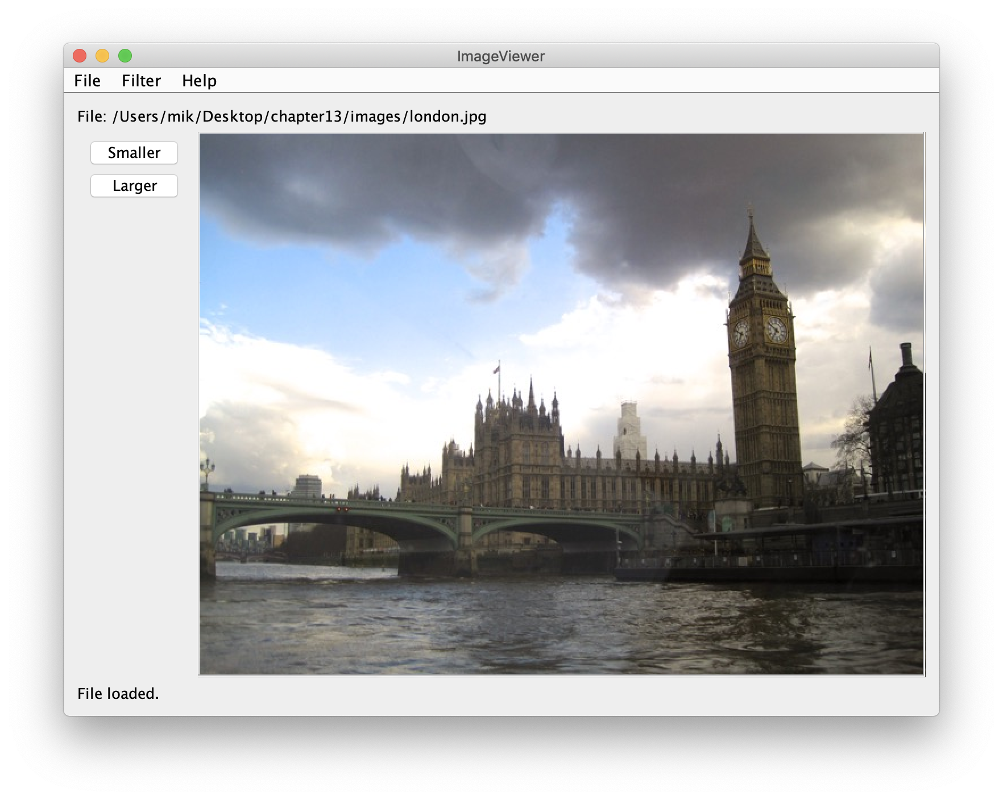
Notes:
Now consider how we create this layout

Slide 19
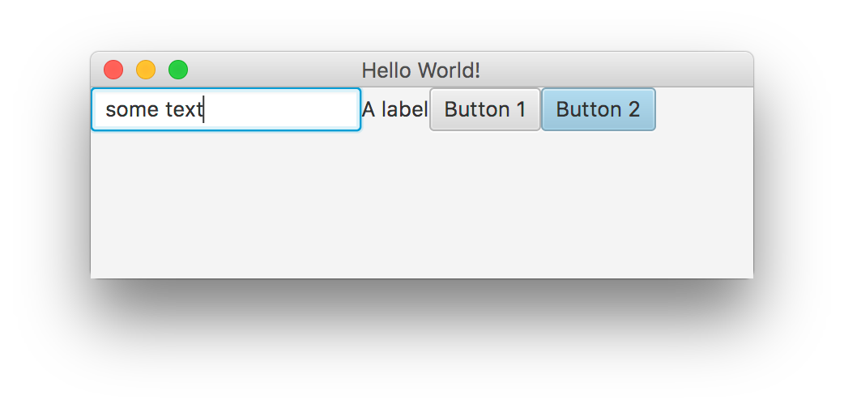
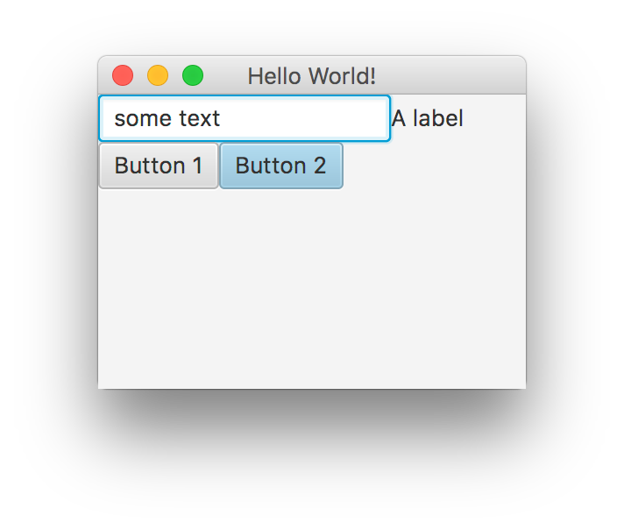

FlowPane
Arranges children like text flow
Honors children’s preferred size

Slide 20
Control sizes
Every node express three wishes:
minimum size
preferred size
maximum size
Layout panes may or may not honour those wishes

Slide 21
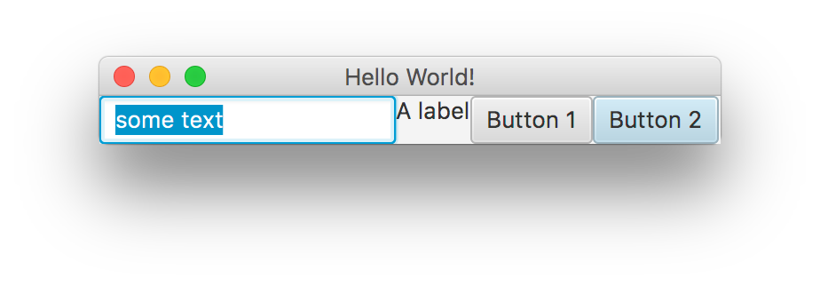
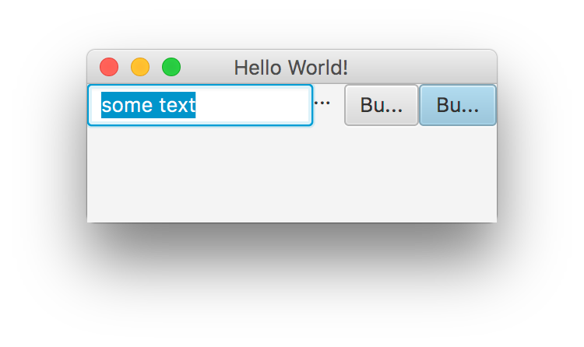
HBox
Keeps children in horizontal row
Reduces them down to min size if necessary

Slide 22
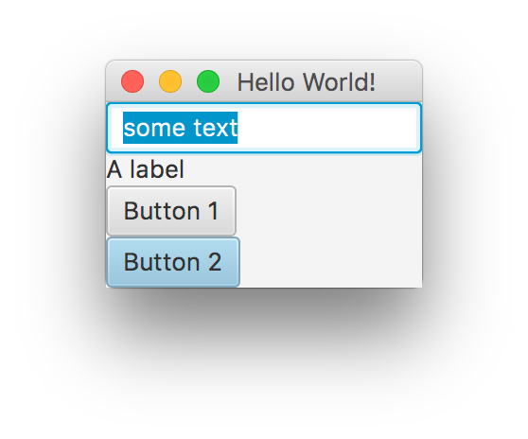
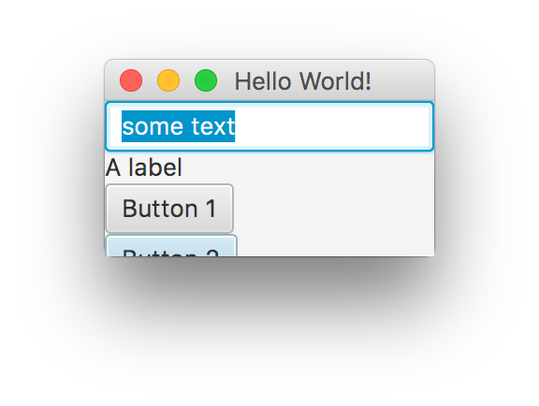
VBox
Same as HBox, but vertical
min == pref for height of these children

Slide 23
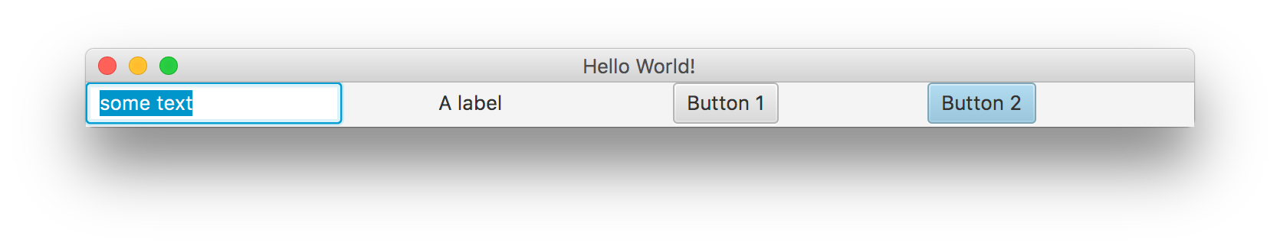
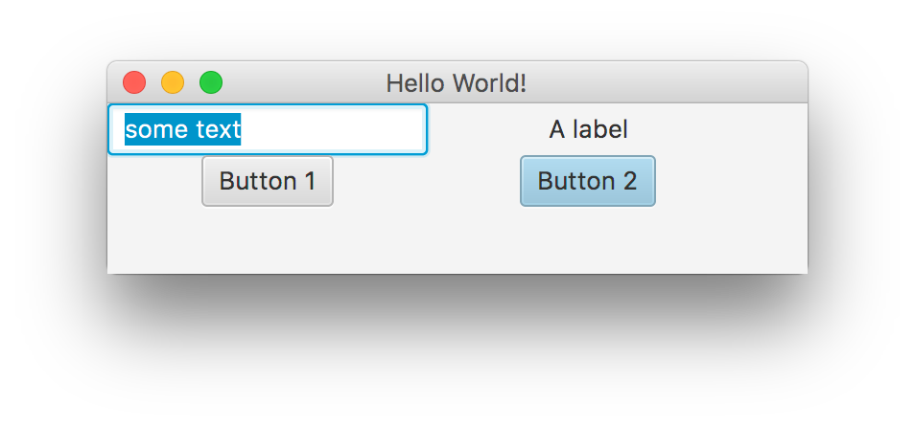
TilePane
Similar to FlowPane, but…
Makes all children same width and height

Slide 24
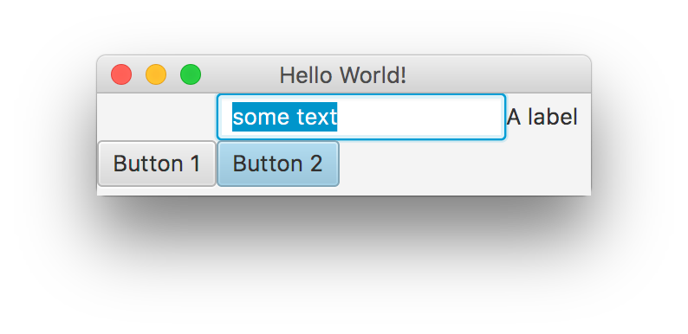
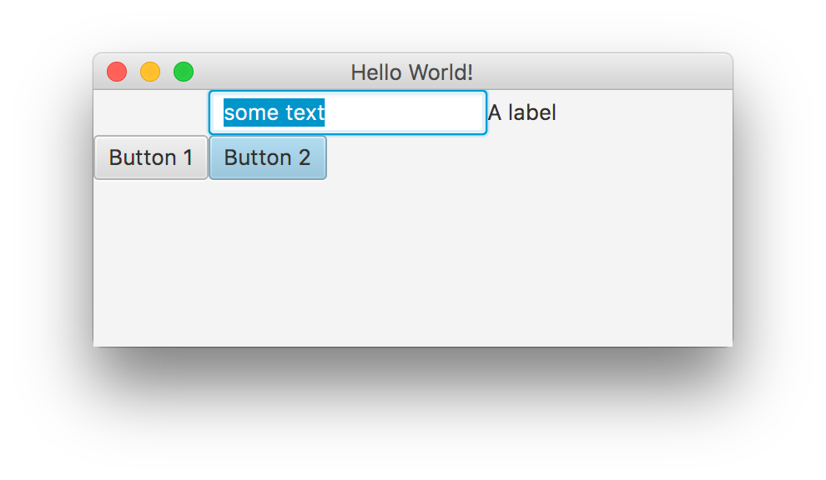
GridPane
Insert into fixed grid at given cell.
Have to use special add methods: gridpane.add(btn, 1, 1);
Very flexible: not all cells have to be filled
Nodes can span multiple cells

Slide 25
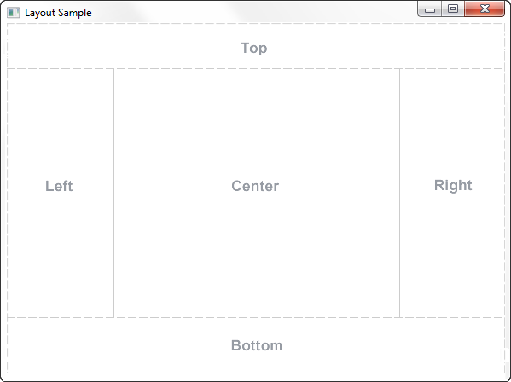
BorderPane

Slide 26
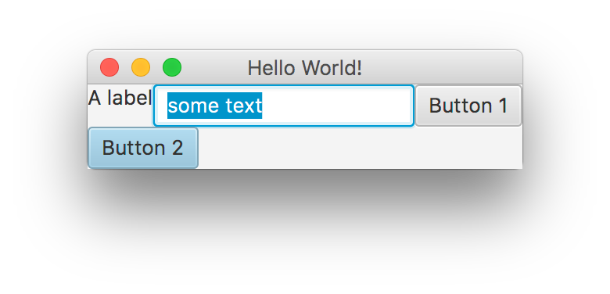
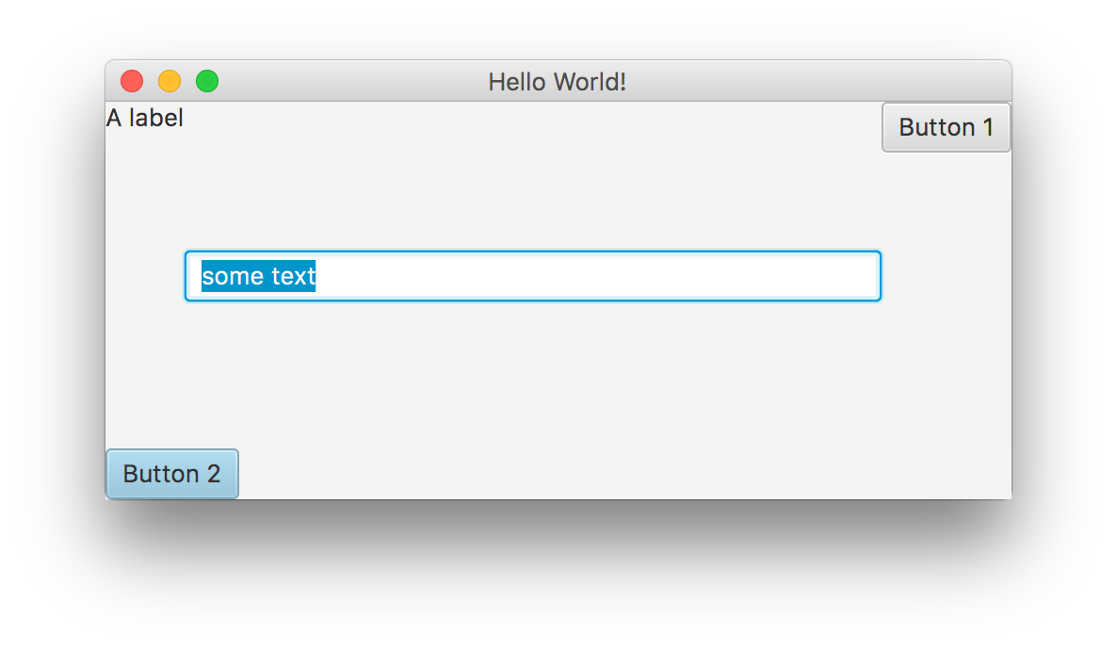
BorderPane
BorderPane root = new BorderPane();
root.setCenter(text);
root.setLeft(lbl);
root.setRight(btn);
root.setBottom(btn2);
Up to five children
Centre gets all the space
Special add methods

Slide 27
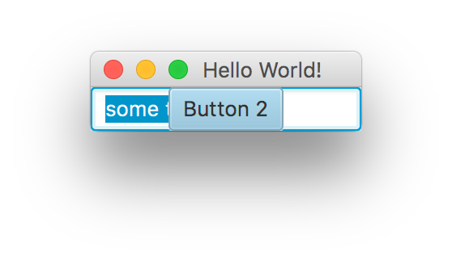
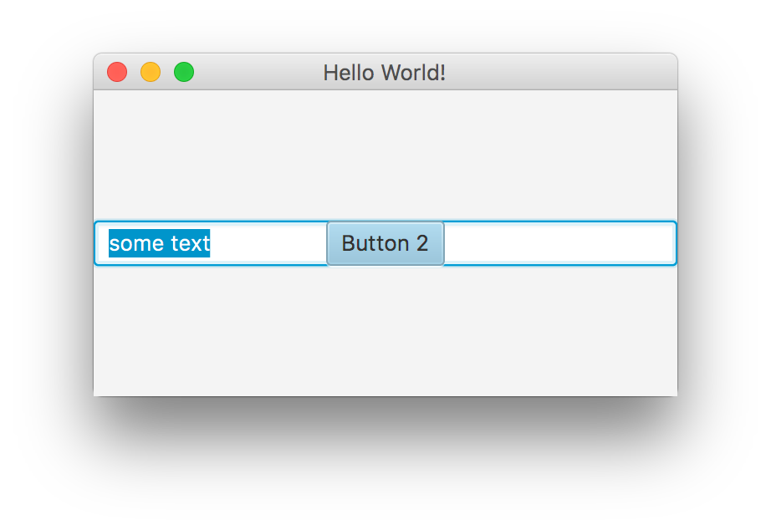
StackPane
Renders in the centre, in the order of entry (first at bottom)

Slide 28
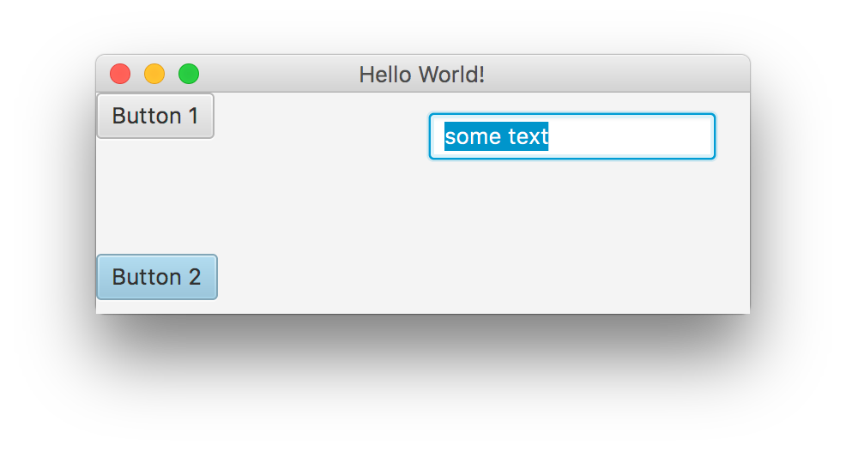
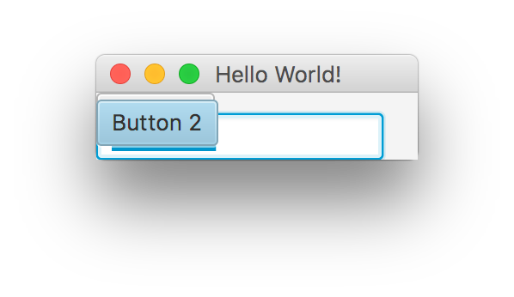
AnchorPane
AnchorPane root = new AnchorPane();
root.getChildren().add(text);
root.getChildren().add(lbl);
root.getChildren().add(btn);
root.getChildren().add(btn2);
AnchorPane.setTopAnchor(text, 12.0);
AnchorPane.setRightAnchor(text, 20.0);
AnchorPane.setBottomAnchor(btn2, 8.0);

Slide 29
Control/Container combinations

Slide 30
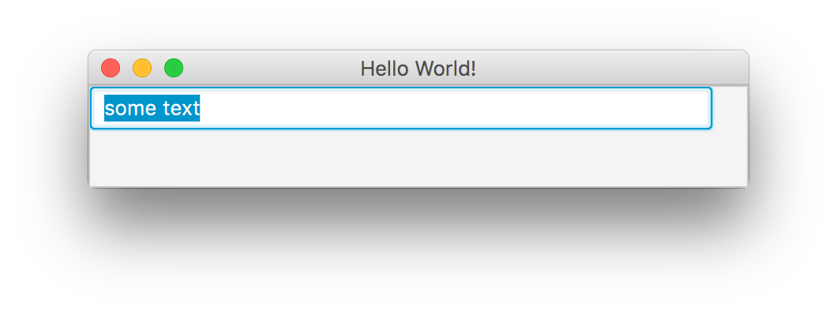
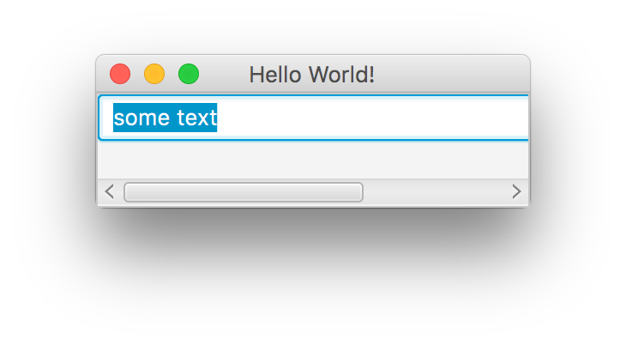
ScrollPane
BorderPane root = new BorderPane();
ScrollPane sp = new ScrollPane();
sp.setVmax(440);
sp.setPrefSize(115, 150);
sp.setContent(text);
root.setCenter(sp);

Slide 31
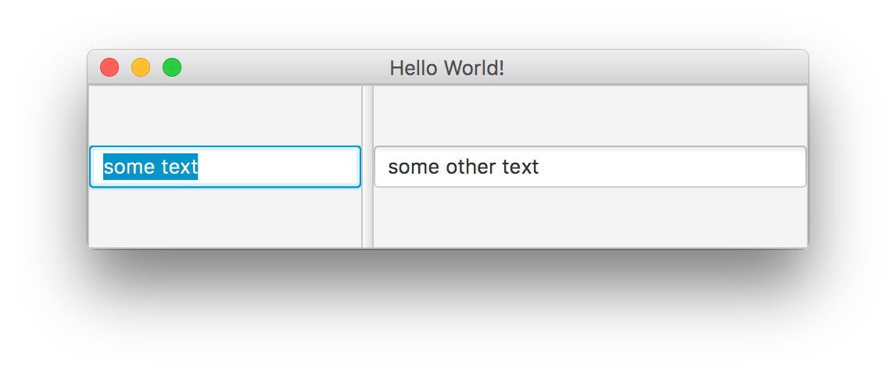
SplitPane
Movable divider
Can be horizontal or vertical

Slide 32
Notes:
How do we now build this?

Slide 33
Nesting layout panes
Notes:
Replace StackPane with FlowPane, TilePane, HBox, VBox

Slide 34
Nested Containers

Slide 35
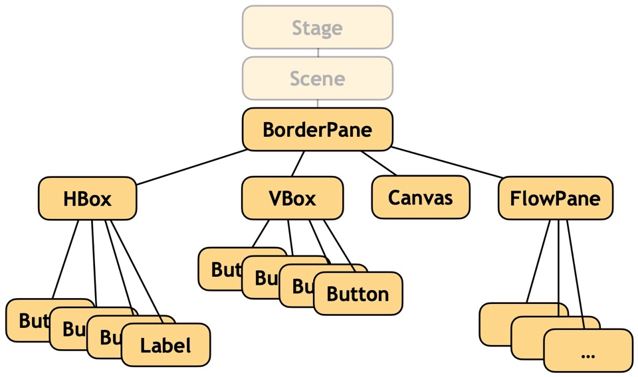
Nested Containers

Slide 36
Nested Containers
All “parent” nodes have children
Held as an internal list
Pane exposes children: ObservableList<Node> getChildren()
Child nodes added by adding to this list: root.getChildren().add(button);
Pane

Slide 37
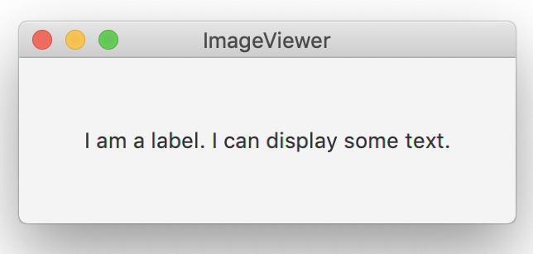
Creating an Application
import javafx.application.Application;
import javafx.stage.Stage;
import javafx.scene.Scene;
import javafx.scene.control.*;
import javafx.scene.layout.*;
public class ImageViewer extends Application
{
/**
* The main entry point for JavaFX programs.
*/
@Override
public void start(Stage stage)
{
Label myLabel = new Label("I am a label. I can display some text.");
StackPane root = new StackPane();
root.getChildren().add(myLabel);
Scene scene = new Scene(root, 300, 100);
stage.setTitle("ImageViewer");
stage.setScene(scene);
stage.show();
}
}
Notes:
Start with FX-ImageViewer0-1 and develop from there

Slide 38
Adding menus
MenuBar
Displayed below the title.
Contains the menus.
Menu
e.g. File. Contains the menu items.
MenuItem
e.g. Open. Individual items.

Slide 39
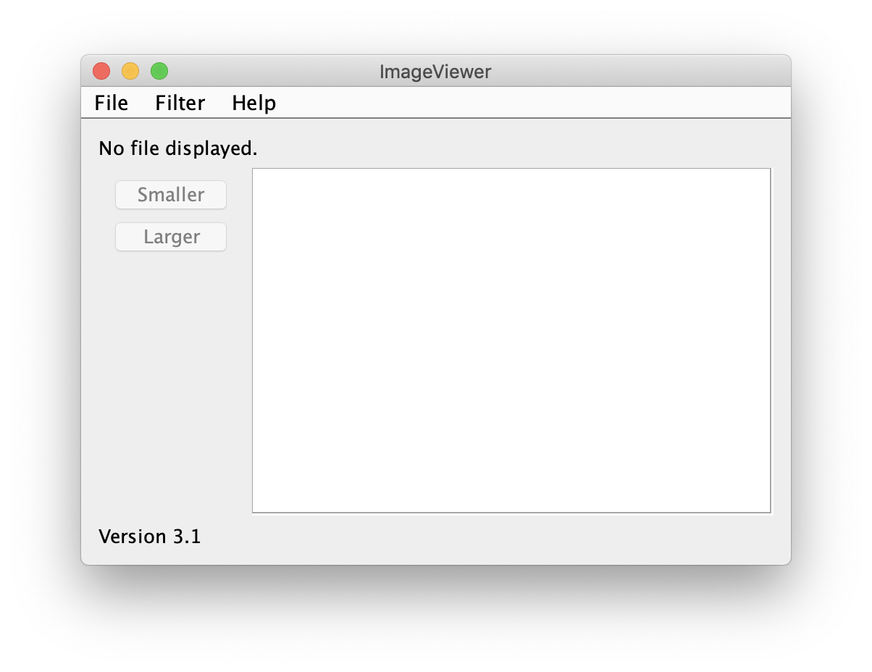
Adding menus
Menus are usually added in a VBox:

Slide 40
private void makeMenuBar(Pane parent)
{
MenuBar menubar = new MenuBar();
parent.getChildren().add(menubar);
Menu fileMenu = new Menu("File");
MenuItem openItem = new MenuItem("Open");
MenuItem quitItem = new MenuItem("Quit");
fileMenu.getItems().addAll(openItem, quitItem);
menubar.getMenus().addAll(fileMenu);
}

Slide 41
Event handling
Events correspond to user interactions with components.
Components are associated with different event types.
Windows (Stages) are associated with WindowEvent.
Menus are associated with ActionEvent.
Lambdas or method references can be attached to components.
They are called when an event occurs. setOnAction (EventHandler<ActionEvent> value)

Slide 42
Lambda for EventHandler
MenuItem openItem = new MenuItem("Open");
openItem.setOnAction(
ev -> System.out.println("Hello")
);
General form
item.setOnAction(ev -> { actions });

Slide 43
Lambda with method call
MenuItem openItem = new MenuItem("Open");
openItem.setOnAction(ev -> openAction(ev));
private void openAction(ActionEvent event)
{
…
}

Slide 44
Lambda with method reference
MenuItem openItem = new MenuItem("Open");
openItem.setOnAction(this::openAction);
private void openAction(ActionEvent event)
{
…
}

Slide 45
Building Graphical User Interfaces
Part II: Layout
7.0
Notes:
Topics this lecture:
intro to helper classes
recap menus, loading image
dialogues
image filters
more layout: info labels, BorderPane

Slide 46
Overview
More layout
Dialogues
Styling with CSS
Implementing image filters

Slide 47
The ImageViewer project

Slide 48
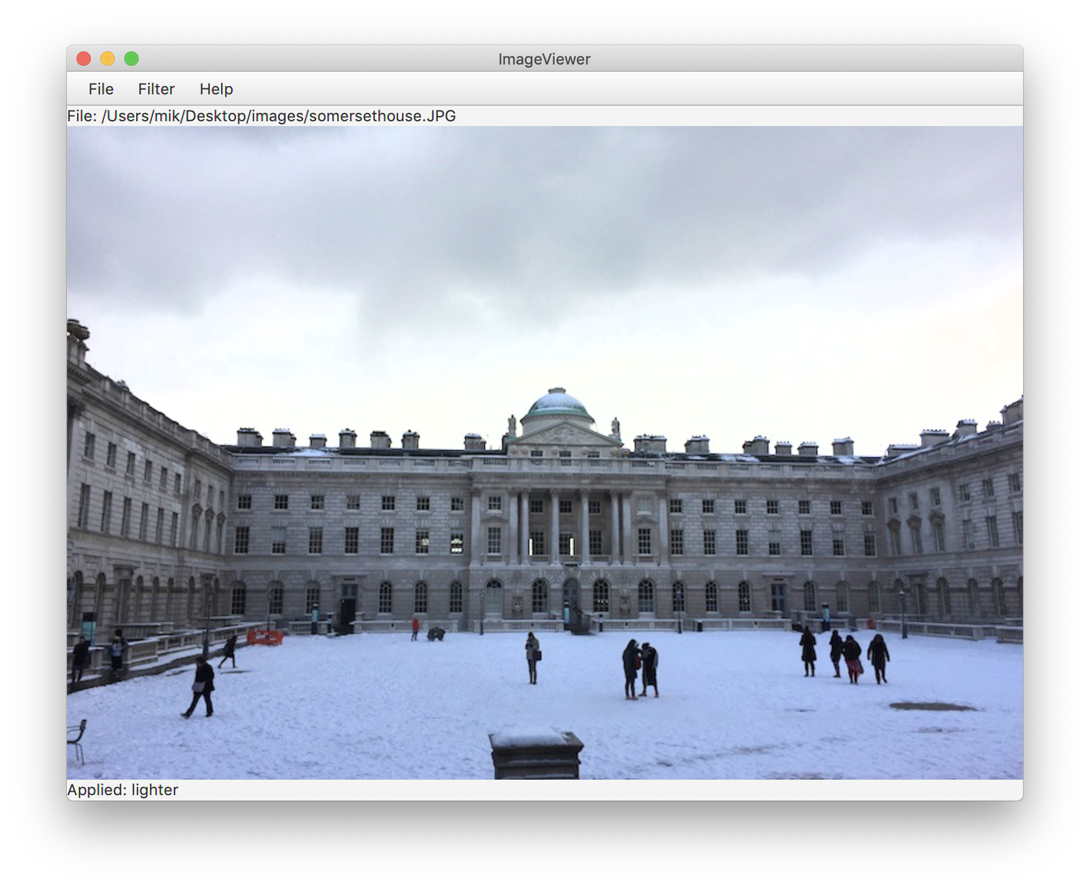
Image processing

Slide 49
Class responsibilities
ImageViewer
Sets up the GUI structure.
ImageFileManager
Static methods for image file loading and saving.
OFImage
Models a 2D image.

Slide 50
OFImage
Our subclass of WritableImage.
Represents a 2D array of pixels.
Important methods:
getPixel, setPixel
getWidthAsInt, getHeightAsInt
Each pixel has a color.
We use javafx.scene.paint.Color.

Slide 51
Adding an image label
public class ImageViewer
{
private Stage stage;
private Label imageLabel;
…
public void start(Stage stage)
{
imageLabel = new Label("", new ImageView(...));
root.getChildren().add(imageLabel);
…
}
…
}

Slide 52
Loading an image
private void openAction(ActionEvent event)
{
File file = fileChooser.showOpenDialog(stage);
if (file != null) { // if the dialogue is cancelled, file is null
openFile(file);
}
}
/**
* Open and display the specified file.
* @param file The file top open. Must not be null.
*/
private void openFile(File file)
{
currentImage = ImageFileManager.loadImage(file);
if (currentImage != null) {
imageLabel.setGraphic(new ImageView(currentImage));
stage.sizeToScene();
}
}

Slide 53
Dialogs
Modal dialogs block all other interaction.
Forces a response from the user.
Non-modal dialogs allow other interaction.
This is sometimes desirable.
May be difficult to avoid inconsistencies.

Slide 54
Alert standard dialogs
Information dialog
Message text plus an OK button.
Warning dialog
Warning icon.
Confirmation dialog
Ok, Cancel options.
Error dialog
Error icon.
Text Input dialog
Label, textfield, buttons.
Choice dialog
Combobox of choices.
Variations with own styling and layout are possible.

Slide 55
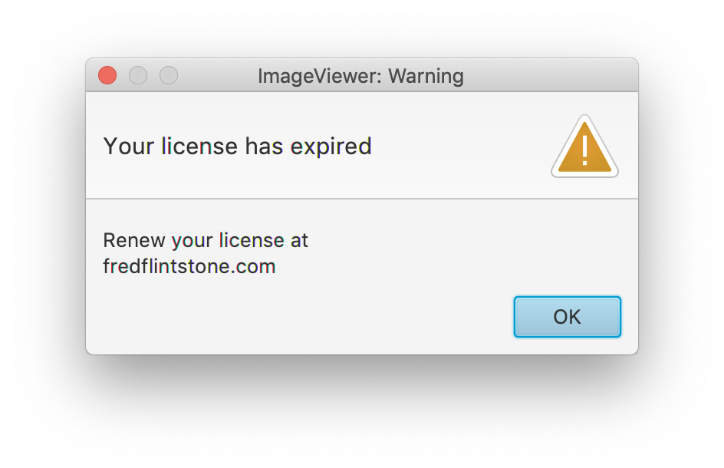
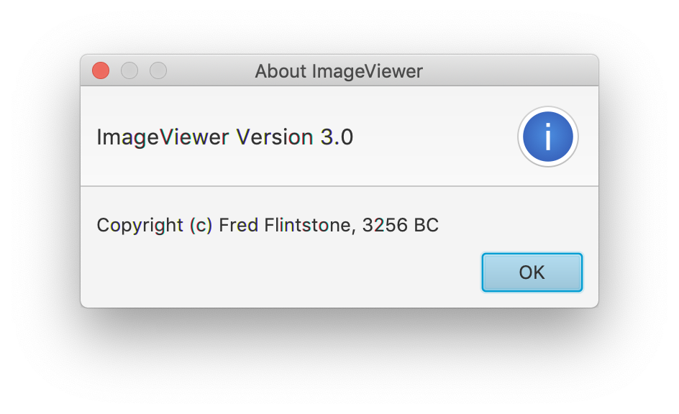
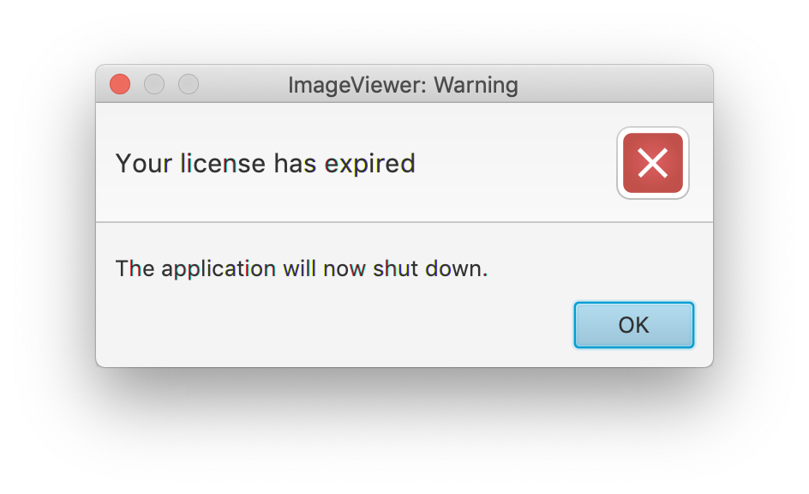
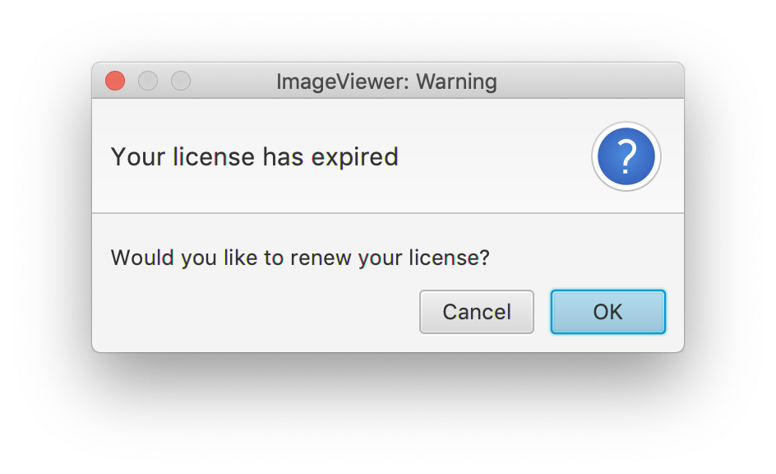
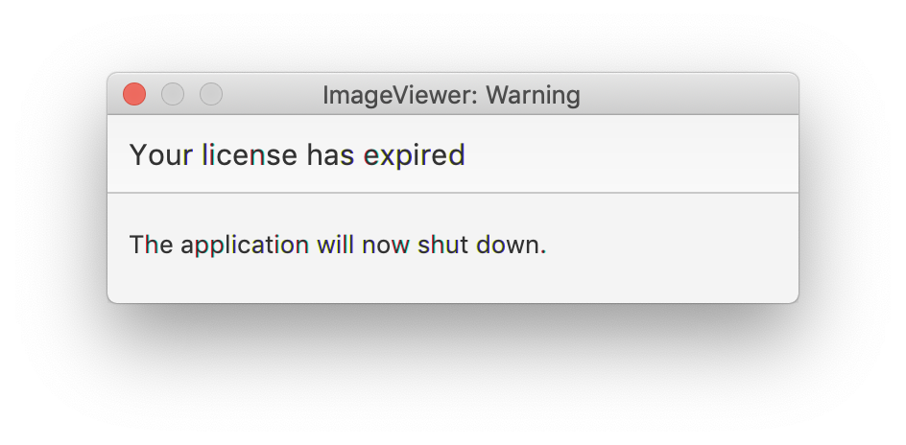
Notes:
Also show BlueJ “Quit All?” dialogue:
point out naming of buttons

Slide 56
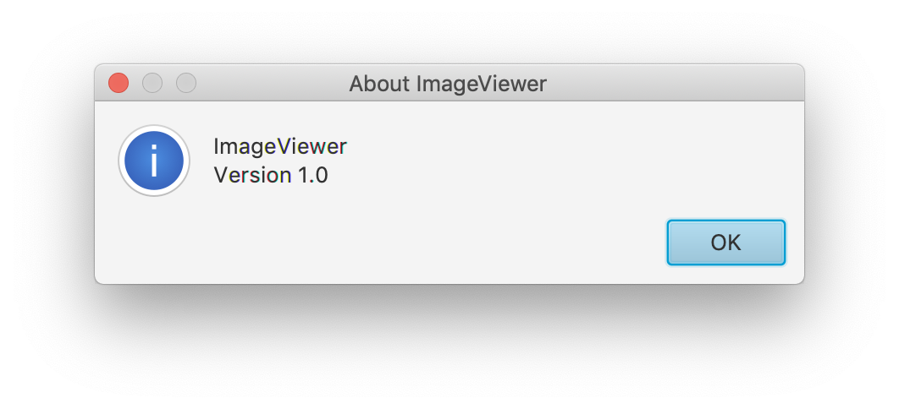
An information dialog
private void showAbout(ActionEvent event)
{
Alert alert = new Alert(AlertType.INFORMATION);
alert.setTitle("About ImageViewer");
alert.setHeaderText(null); // Alerts have an optional header.
alert.setContentText("ImageViewer\n" + VERSION);
alert.showAndWait();
}

Slide 57
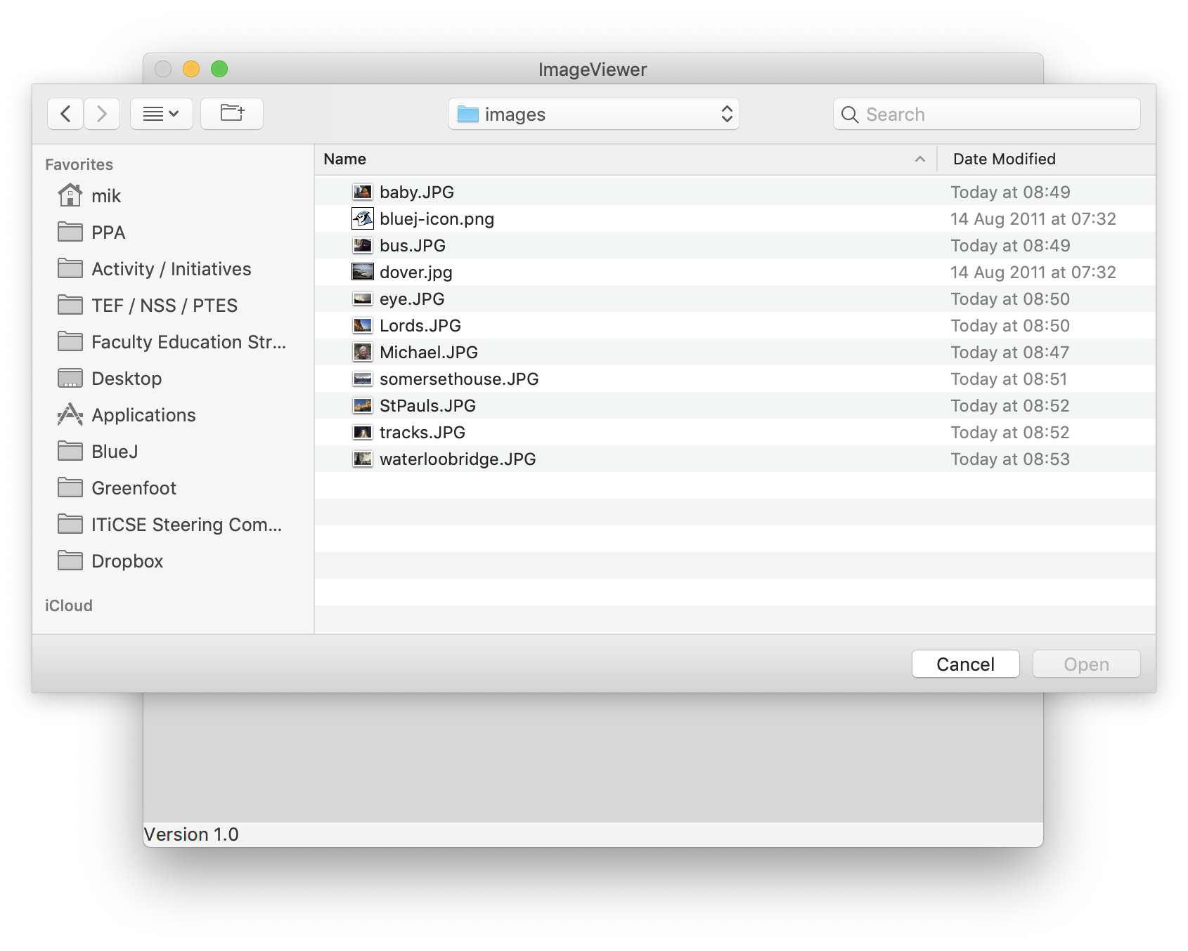
File open dialogue

Slide 58
Image filters
Functions applied to the whole image.
int height = getHeightAsInt();
int width = getWidthAsInt();
for(int y = 0; y < height; y++) {
for(int x = 0; x < width; x++) {
Color pixel = getPixel(x, y);
alter the pixel's color value;
setPixel(x, y, pixel);
}
}
Notes:
use
setPixel(x, y, getPixel(x, y).darker());
for demo. then use
FX-ImageViewer1-0

Slide 59
Adding further filters
Code duplication?
Refactor!
private void makeLighter()
{
if(currentImage != null) {
currentImage.lighter();
frame.repaint();
showStatus("Applied: lighter");
}
else {
showStatus("No image loaded.");
}
}
private void threshold()
{
if(currentImage != null) {
currentImage.threshold();
frame.repaint();
showStatus("Applied: threshold");
}
else {
showStatus("No image loaded.");
}
}

Slide 60
Adding further filters
Define a Filter superclass (abstract).
Create function-specific subclasses.
Create a collection of subclass instances in ImageViewer.
Define a generic applyFilter method.
See FX-ImageViewer2-0.

Slide 61
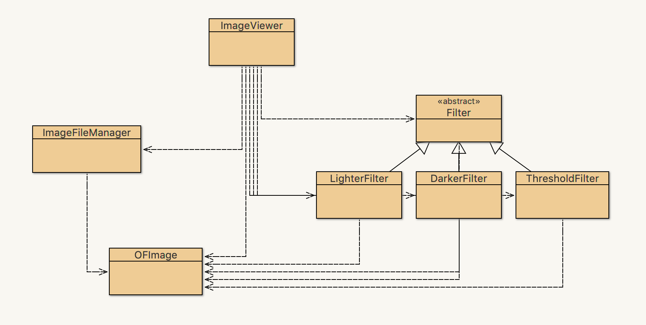
FX-ImageViewer2-0

Slide 62
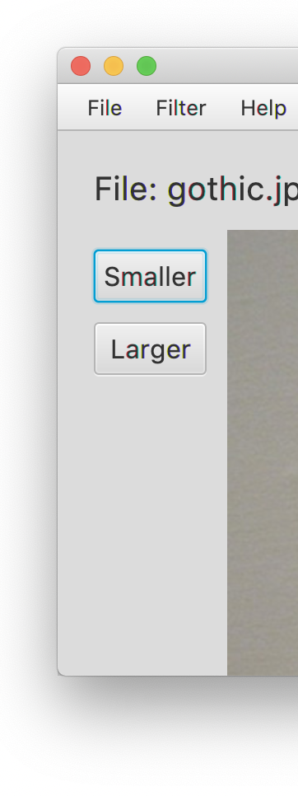
Buttons and nested layouts
A VBox inside
a BorderPane
inside a VBox.

Slide 63
Adding spacing
Can be done programatically (in Java code) …
… but we prefer to do this externally in CSS.

Slide 64
Styling with CSS

Slide 65
Styling nodes with CSS
Nodes can be styled in Java code
Better: use CSS for styling
Similar to using CSS for HTML
JavaFX CSS based on W3C CSS v 2.1
… with some additions from v 3 and some extensions for JavaFX

Slide 66
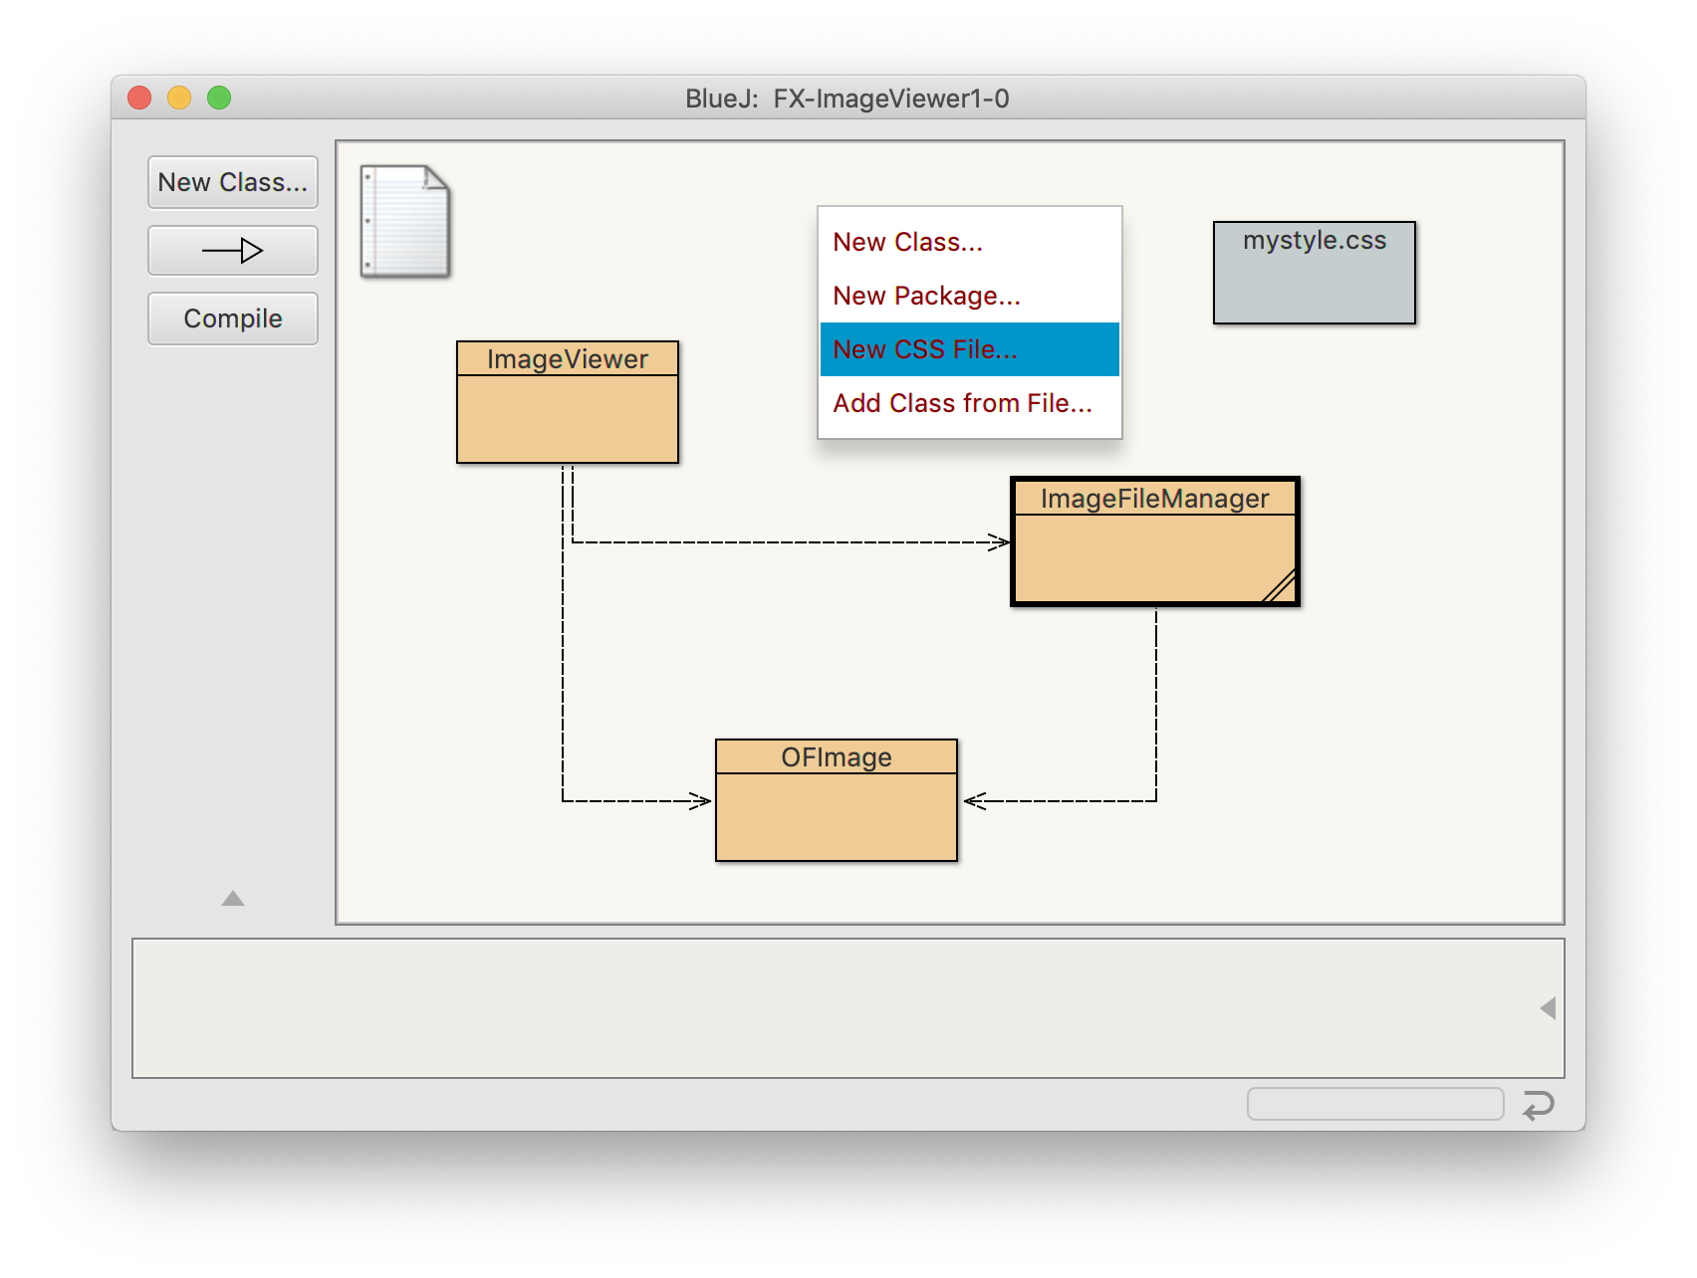
Working with style sheets
Style sheets can be added in BlueJ
*.css files in the project folder

Slide 67
Working with style sheets
Usually have a .css suffix
Usually located in a subdirectory of the application’s classpath
Style sheets are applied to Scene objects: Scene scene = new Scene(root); scene.getStylesheets().add(“mystyle.css”);

Slide 68
Defining styles
name (aka “selector”); starts with dot
.button { -fx-font: 16px "Serif"; -fx-padding: 10; -fx-background-color: #CCFF99; }
rules (in curly brackets)
Notes:
use for .button

Slide 69
Selectors
Selectors correspond to class names
Use lowercase, and hyphens:
Class
Button
CheckBox
ScrollBar
Selector
.button
.check-box
.scroll-bar
Notes:
style the buttons, using .button

Slide 70
.button {
-fx-font: 16px "Serif";
-fx-padding: 50;
-fx-background-color: #CC4499;
}
.label {
-fx-font: 56px "Monaco";
}
Notes:
try styling .label
-> will also style menubar

Slide 71
Defining new style classes
You can define and use your own style classes:
Java
btn.getStyleClass().add("mybutton");
CSS
.mybutton{
-fx-background-color: #DFB951;
-fx-border-radius: 20;
-fx-background-radius: 20;
}
Notes:
use for labels: add infoLabel class for font-size and padding

Slide 72
ID selectors
Styled can be defined for single nodes by using an ID:
Java
btn.setId(“special”);
CSS
#special {
-fx-font: 56px "Monaco";
}
Notes:
use for #toolbar padding and spacing

Slide 73
Compound selectors
Some controls consist of separate elements. These can be styled separately.
Use selector for class, space, and selector for element class:
Selectors
.check-box .label
.check-box .box
.radio-button .dot

Slide 74
Pseudo classes
Pseudo classes can be used to style nodes in a specific state, for example on mouse-over
Written with colon:
Selectors
.radio-button:focused
.radio-button:hover
.scroll-bar:vertical

Slide 75
Rules and properties
CSS rules assign node properties
Rule property names correspond to class properties
JavaFX style rules start with -fx:
Rules
-fx-background-color: #333333;
-fx-text-fill: white;
-fx-alignment: CENTER;

Slide 76
Styling root
The .root style class is applied to the root node of the Scene instance
The scene can easily be skinned using .root:
.root{
-fx-font-size: 16pt;
-fx-font-family: "Courier New";
-fx-base: rgb(132, 145, 47);
-fx-background: rgb(225, 228, 203);
}

Slide 77
Scene Graph
Stage
Scene
BorderPane
BorderPane
VBox
Canvas
TilePane
VBox
Label
Canvas
Button
Button
Button
Button
…
…
…

Slide 78
Full documentation
https://docs.oracle.com/javafx/2/api/javafx/scene/doc-files/cssref.html

Slide 79
Review
Aim for cohesive application structures.
Endeavour to keep GUI elements separate from application functionality.
Pre-defined components simplify creation of sophisticated GUIs.
Layout managers handle component juxtaposition.
Nest containers for further control.

Slide 80
Review
Many components recognise user interactions with them.
Reactive components deliver events to listeners.
Lambdas or method references are commonly used to implement listeners.
Use CSS to style your interface.

